Slide 1
Speculative tomasulo’s algorithm
Muhammed Khalid 44
Mahmoud Kamal 51
Mariam Tarek 53
Mona Khalid 60
Nihal Khalid 64
under the supervision of
Dr. May Muhammed

Slide 2
introduction
Hardware-based speculation combines three key ideas: dynamic branch prediction to choose which instructions to execute, speculation to allow the execution of instructions before the control dependences are resolved and dynamic scheduling to deal with the scheduling of different combinations of basic blocks.
Hardware-based speculation follows the predicted flow of data values to choose when to execute instructions. This method of executing programs is essentially a data-flow execution: operations execute as soon as their operands are available.
The key idea behind implementing speculation is to allow instructions to execute out of order but to force them to commit in order and to prevent any irrevocable action until an instruction commits.

Slide 3
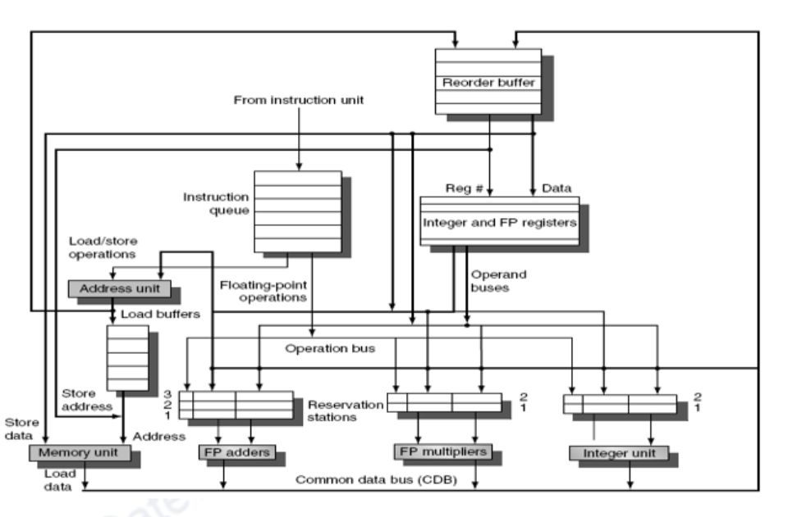
Diagram of tomasulo with rob

Slide 4
Instruction phases
There are four stages involved in instruction execution:
Issue
Execute
Write result
Commit

Slide 5
Instruction phases – issue
Get next instruction from FIFO queue
If available RS entry and ROB entry, issue the instruction
If a RS or ROB entry is not available, it becomes a structural hazard and the instruction stalls
If an earlier instruction is not issued, then subsequent instructions cannot be issued
If operands are available read them and store them in the reservation station
Operands can be read from the register file (already committed instructions) or from the ROB (executed but not yet committed)
Operands dependent on an earlier instruction are identified by their corresponding ROB tag in the Q field and such instructions will have to stall till data becomes available

Slide 6
Instruction phases – Execute
The CDB broadcasts data with an ROB tag and when an operand becomes available, store it in any reservation station waiting for it
When all operands are ready, issue the instruction for execution
Free the reservation station entry once the instruction moves into execution
Loads and store are maintained in program order through the effective address
Even with pending branches, instructions are speculatively executed

Slide 7
Instruction phases – write result
When the result is available, write it on the CDB and from the CDB into the ROB, as well as to any reservation stations waiting for this result. If the value to be stored is not available yet, the CDB must be monitored until that value is broadcast, at which time the Value field of the ROB entry of the store is updated.

Slide 8
Instruction phases – Commit
There are three different sequences of actions at commit depending on whether the committing instruction is: a branch with an incorrect prediction, a store, or any other instruction (normal commit). The normal commit case occurs when an instruction reaches the head of the ROB and its result is present in the buffer; at this point, the processor updates the register with the result and removes the instruction from the ROB.
Committing a store is similar except that memory is updated rather than a result register. When a branch with incorrect prediction reaches the head of the ROB, it indicates that the speculation was wrong. The ROB is flushed and execution is restarted at the correct successor of the branch. If the branch was correctly predicted, the branch is finished. Some machines call this commit phase completion or graduation.

Slide 9
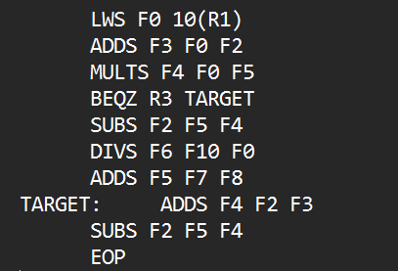
simulation
The set of instructions:
Adder → 2 Cycles
Divider → 40 Cycles
Integer → 2 Cycles
Memory → 1 Cycle
Multiplier → 10 Cycles
Divider → 40 Cycles

Slide 10
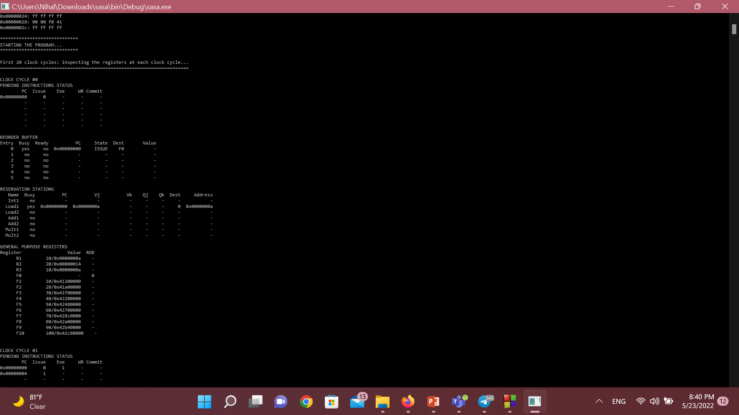
Simulation – cont.

Slide 11
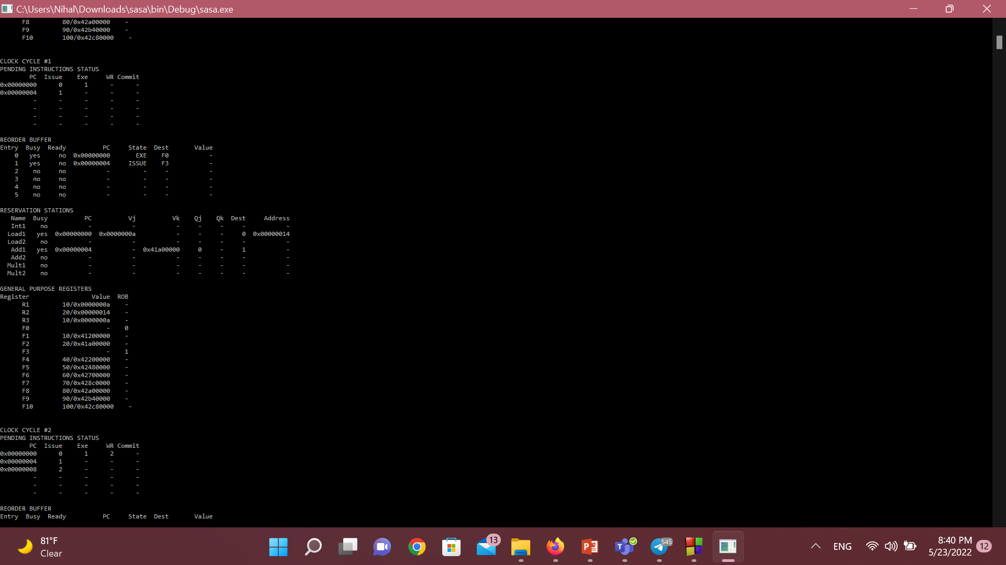
Simulation – cont.

Slide 12
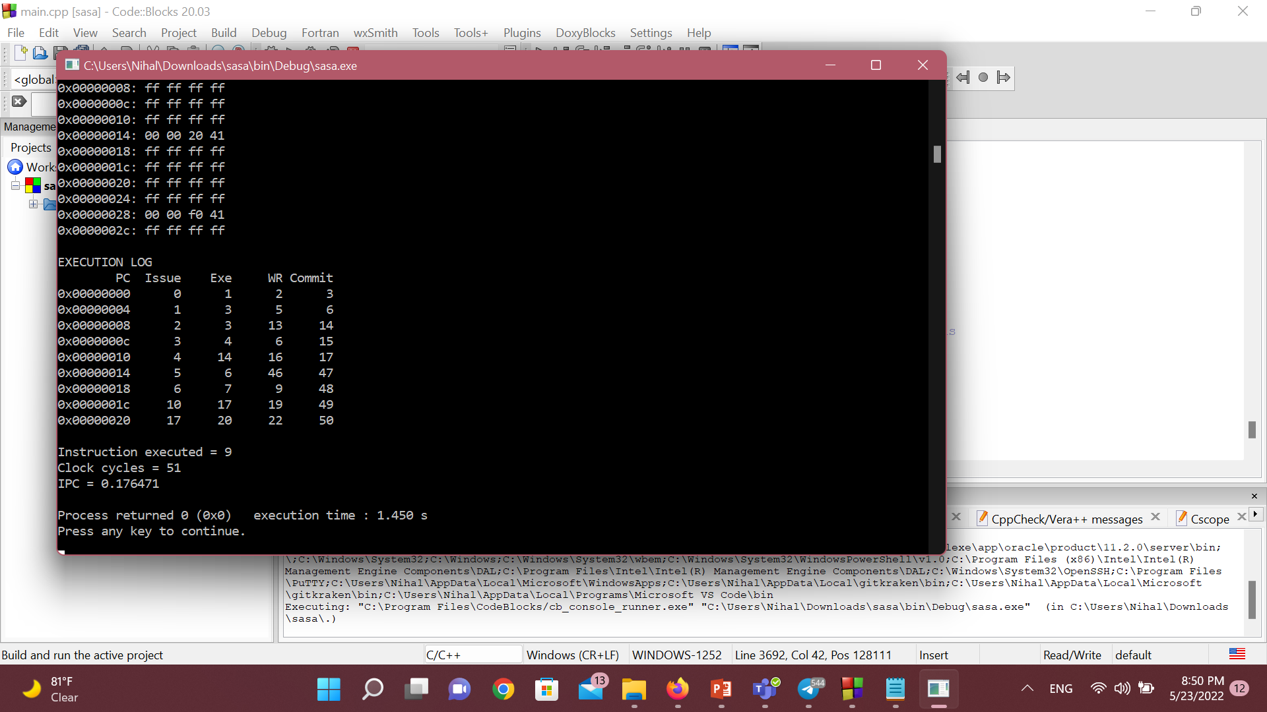
Simulation – cont.

Slide 13
Link
GitHub - MahmoudKamal01/Speculative-tomasulo-Algorithm-

Slide 14
Thank you

